Slide 1
5305 Project Description

Slide 2
Project Description
Given the application requirement:
R1. See the OnlineStore Conceptual Model described in SQL (file ‘onlinestore-schema.sql’).
R2. See the Query and Update patterns (file ‘onlinestore-queries.info’).
R3. A sample OnlineStore dataset represented in SQL tables (‘onlinestore_dataset_dump.sql’) according to the definition in file ‘onlinestore-schema.sql’. Load ‘onlinestore_dataset_dump.sql’ to MySQL.
Use MongoDB
T1. Design the corresponding Document model for data R1 and queries/updates R2 above.
T2. Transform the sample dataset R3 to the corresponding NoSQL schemas in T1, and load the transformed data to MongoDB.
T3. Implement the queries and updates through the Java driver of Mongo DB. User can choose a query/update and enter parameter values, and results are returned.

Slide 3
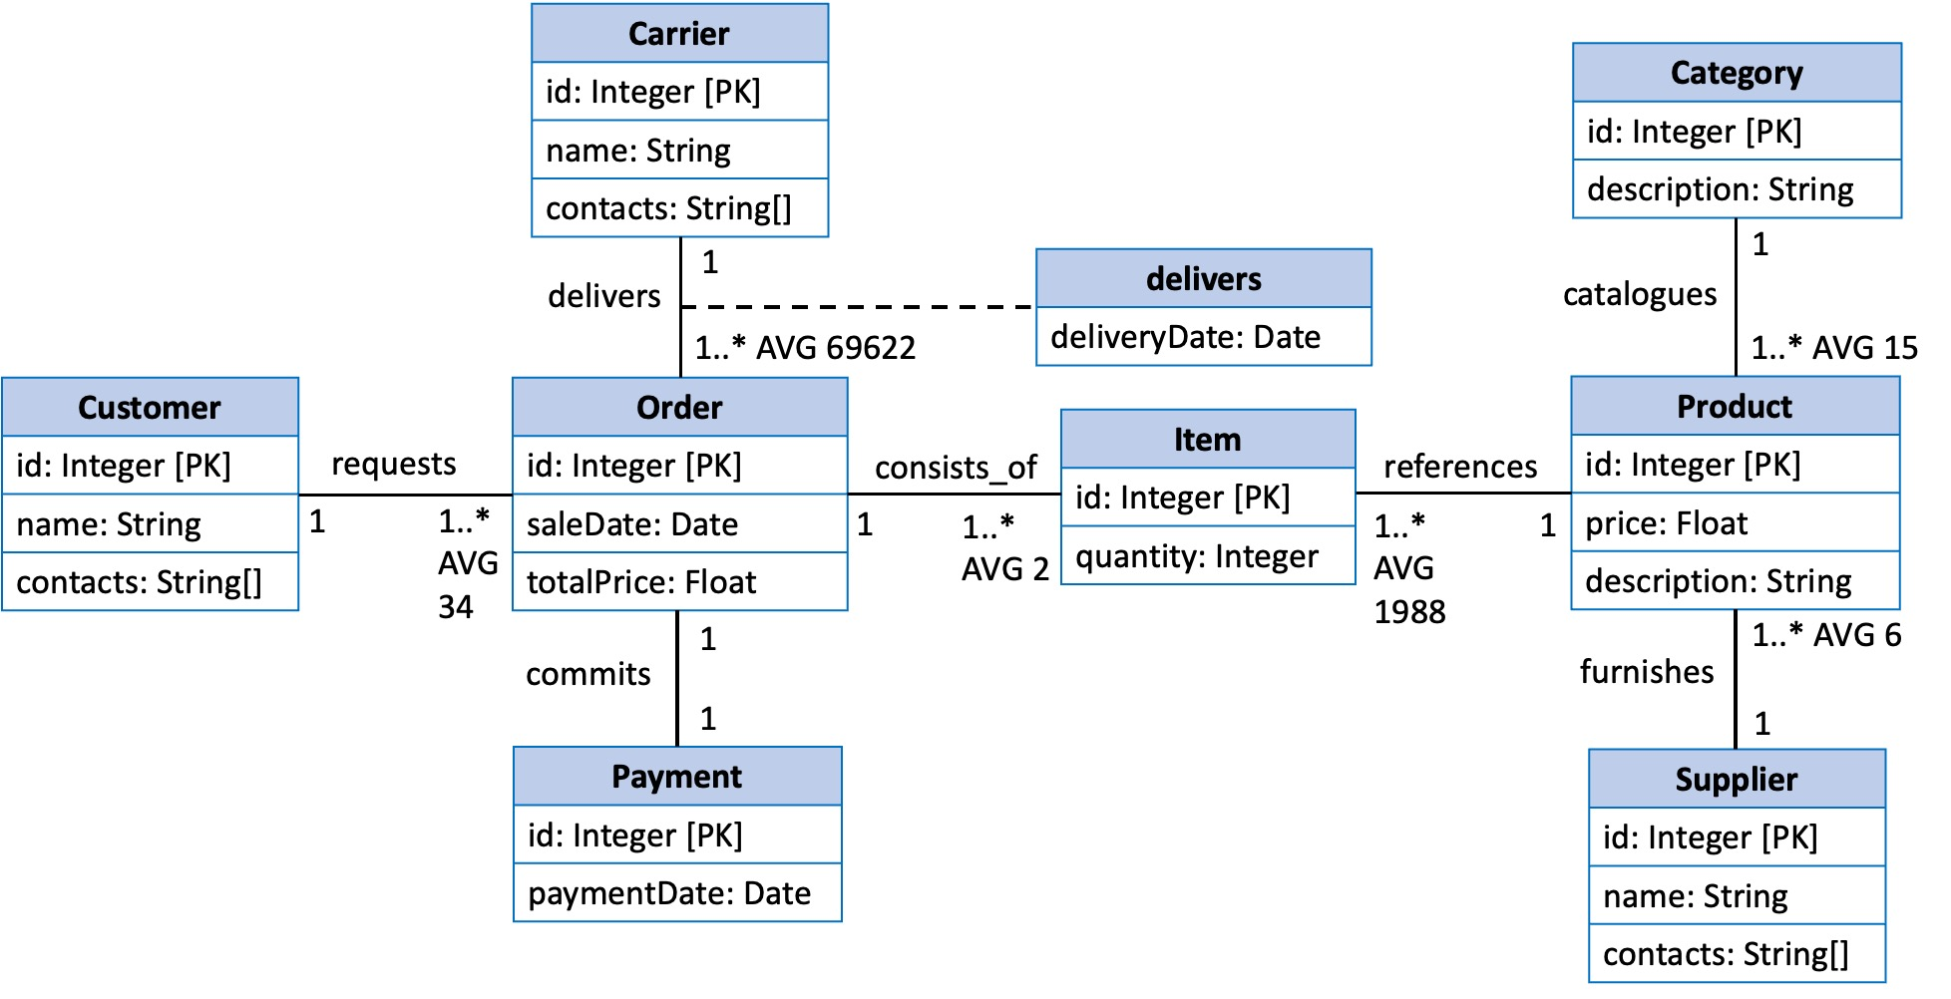
OnlineStore- Conceptual Model
Corresponding SQL design is given in ‘onlinestore-schema.sql’.

Slide 4
OnlineStore – Query and Update Cases
Query is represented in a SQL-like pattern. Those queries are not executable but describes how data are accessed.
Update pattern describes the tasks of one update.
--Q1
SELECT Order.id, Order.saleDate, Order.totalPrice, Customer.id, Customer.name, Customer.contacts,
Item.id, Item.quantity, Product.id, Product.price, Product.description
FROM Order.consists_of.Item.references.Product,Order.requests.Customer (class_name.relationship_name. class_name, …)
WHERE Order.id = ?;
place an order: insert an order and its relationships with customer and products (creating items).

Slide 5
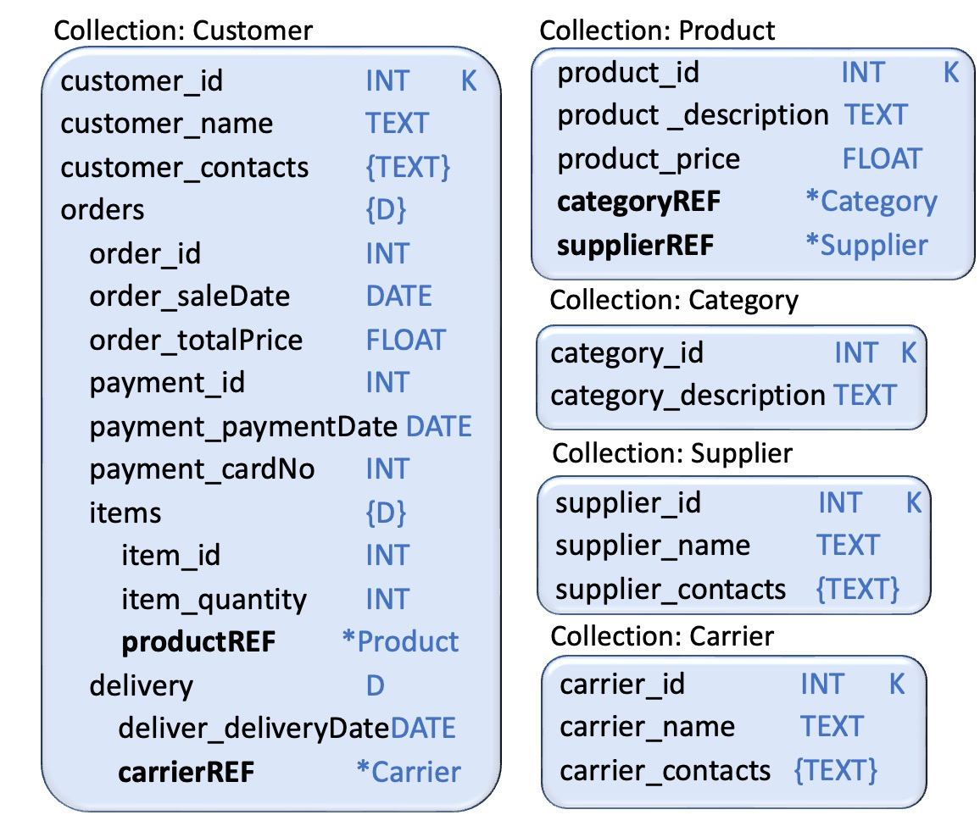
An Example Document Model for OnlineStore
Data can be embedded in one document as shown in Collection:Customer.
Joins can be avoided to improve the query performance.
Design your document models for the aformentioned data and queries.

Slide 6
MongoDB
MongoDB database system version recommended: 5.0.5.
Install mongodb-database-tools (version 100.5.2) for ‘mongoimport’ tool to load sample dataset.
MongoDB java driver version recommended:
Please install the database system, use it and learn the model features. https://www.mongodb.com/
<dependency> <groupId>org.mongodb</groupId> <artifactId>mongo-java-driver</artifactId> <version>3.11.0</version> </dependency>

Slide 7
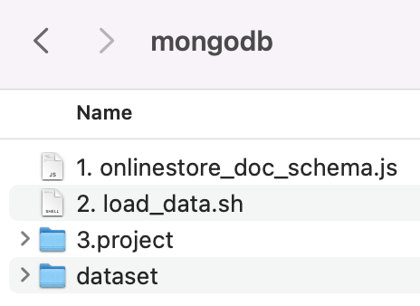
Requirements and Marking Scheme
Files you need to complete:
Basic requirement: your submitted project must be executable (80 points), otherwise 0 point.
’load_data.sh’ works properly and data can be sucessfully loaded to MongoDB (30 points).
All 10 queries and updates can return the correct results with the given parameter values (5 points each query/update).
For all 10 queries and updates, the efficiency is satisfactory. (20 points)
Ultilize the features of MongoDB, and design the model based on the query and update patterns.
Query/update efficiency and the overall performance are the measurements of your project.
(A fancy GUI or other extra functionalities will not get anyextra points.)

